Slide 1



OLA Data Analysis
View in Power BI
Last data refresh:
9/5/2025 6:56:18 PM UTC
Downloaded at:
9/6/2025 8:17:24 PM UTC

Slide 2
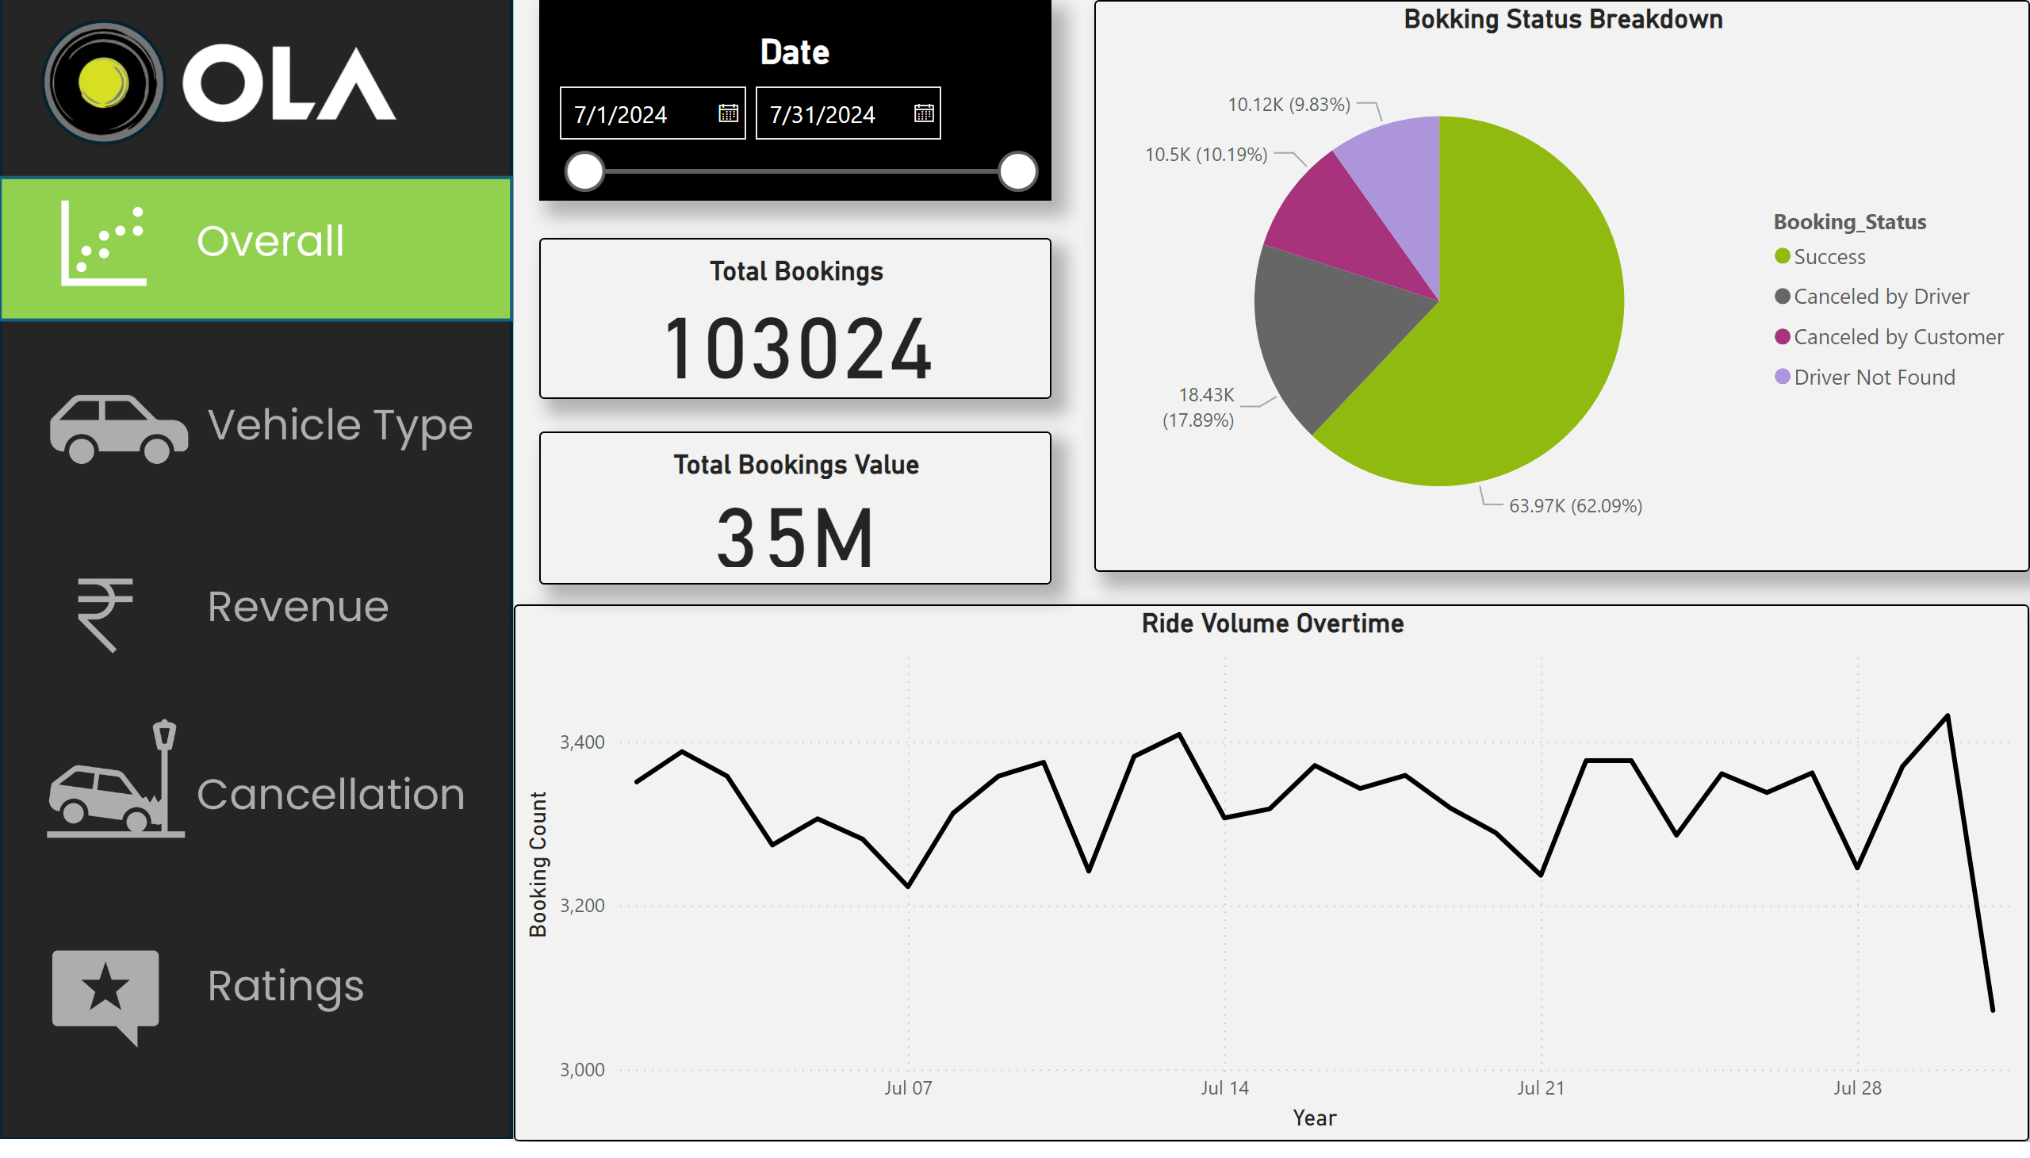
Overview
Notes:
actionButton
No alt text provided
actionButton
No alt text provided
actionButton
No alt text provided
actionButton
No alt text provided
actionButton
No alt text provided
Ride Volume Overtime
No alt text provided
Bokking Status Breakdown
No alt text provided
Date
No alt text provided
Total Bookings
No alt text provided
Total Bookings Value
No alt text provided

Slide 3
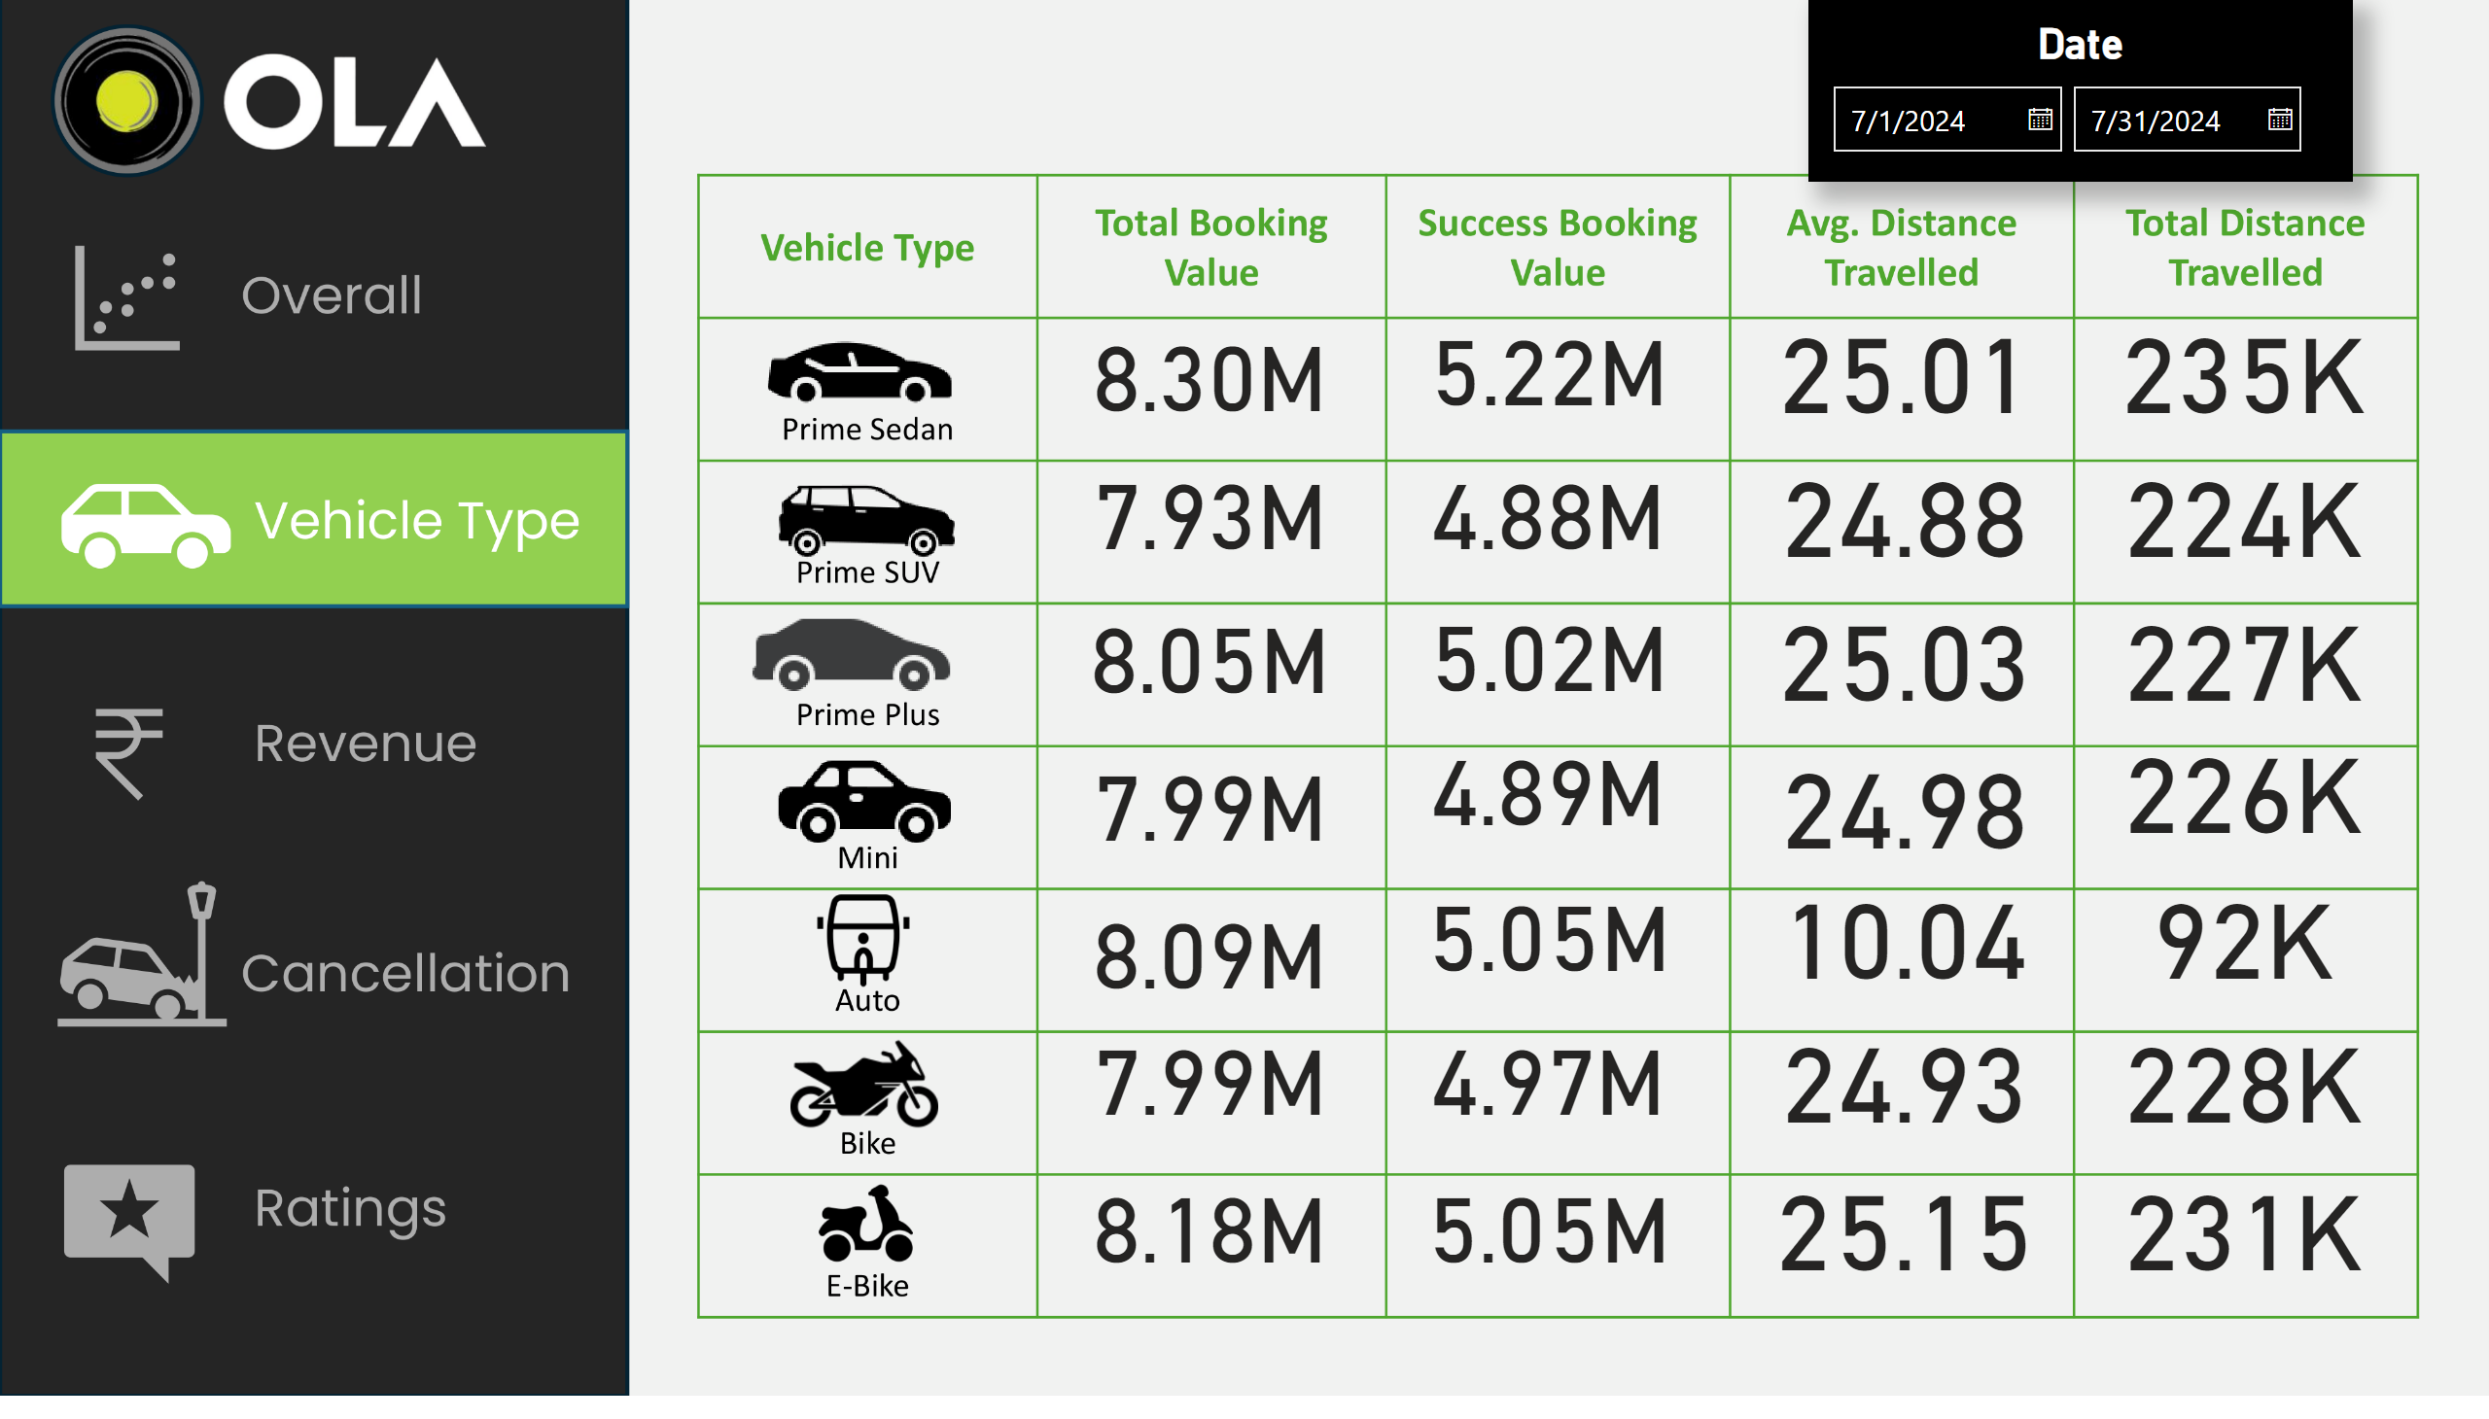
Vehicle Type
Notes:
actionButton
No alt text provided
actionButton
No alt text provided
actionButton
No alt text provided
actionButton
No alt text provided
actionButton
No alt text provided
card
No alt text provided
card
No alt text provided
card
No alt text provided
card
No alt text provided
card
No alt text provided
card
No alt text provided
card
No alt text provided
card
No alt text provided
card
No alt text provided
card
No alt text provided
card
No alt text provided
card
No alt text provided
card
No alt text provided
card
No alt text provided
card
No alt text provided
card
No alt text provided
card
No alt text provided
card
No alt text provided
card
No alt text provided
card
No alt text provided
card
No alt text provided
card
No alt text provided
card
No alt text provided
card
No alt text provided
card
No alt text provided
card
No alt text provided
card
No alt text provided
card
No alt text provided
Date
No alt text provided

Slide 4
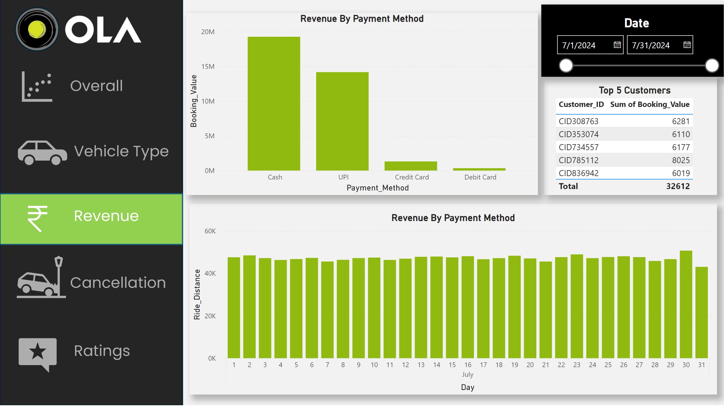
Revenue
Notes:
actionButton
No alt text provided
actionButton
No alt text provided
actionButton
No alt text provided
actionButton
No alt text provided
actionButton
No alt text provided
Revenue By Payment Method
No alt text provided
Revenue By Payment Method
No alt text provided
Top 5 Customers
No alt text provided
Date
No alt text provided

Slide 5
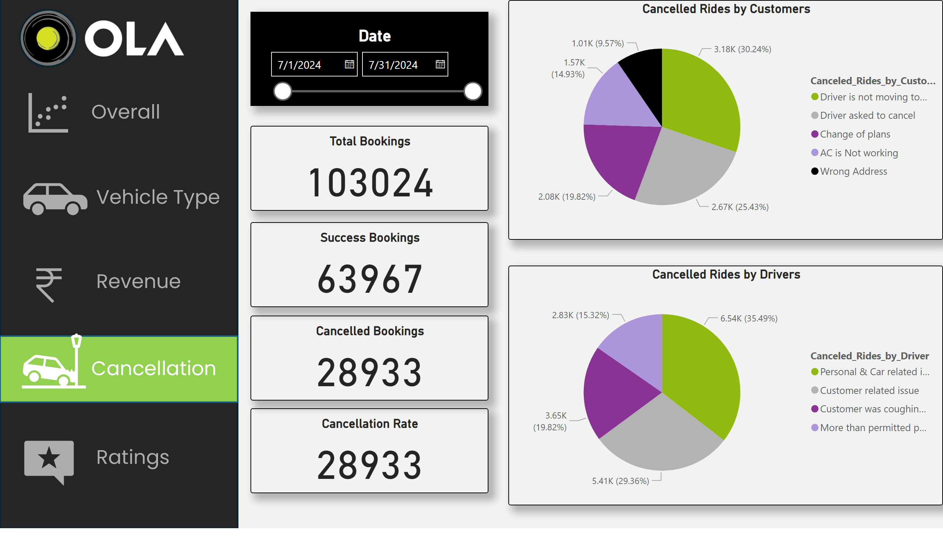
Cancellation
Notes:
actionButton
No alt text provided
actionButton
No alt text provided
actionButton
No alt text provided
actionButton
No alt text provided
actionButton
No alt text provided
Cancelled Rides by Drivers
No alt text provided
Cancelled Rides by Customers
No alt text provided
Cancellation Rate
No alt text provided
Cancelled Bookings
No alt text provided
Success Bookings
No alt text provided
Total Bookings
No alt text provided
Date
No alt text provided

Slide 6
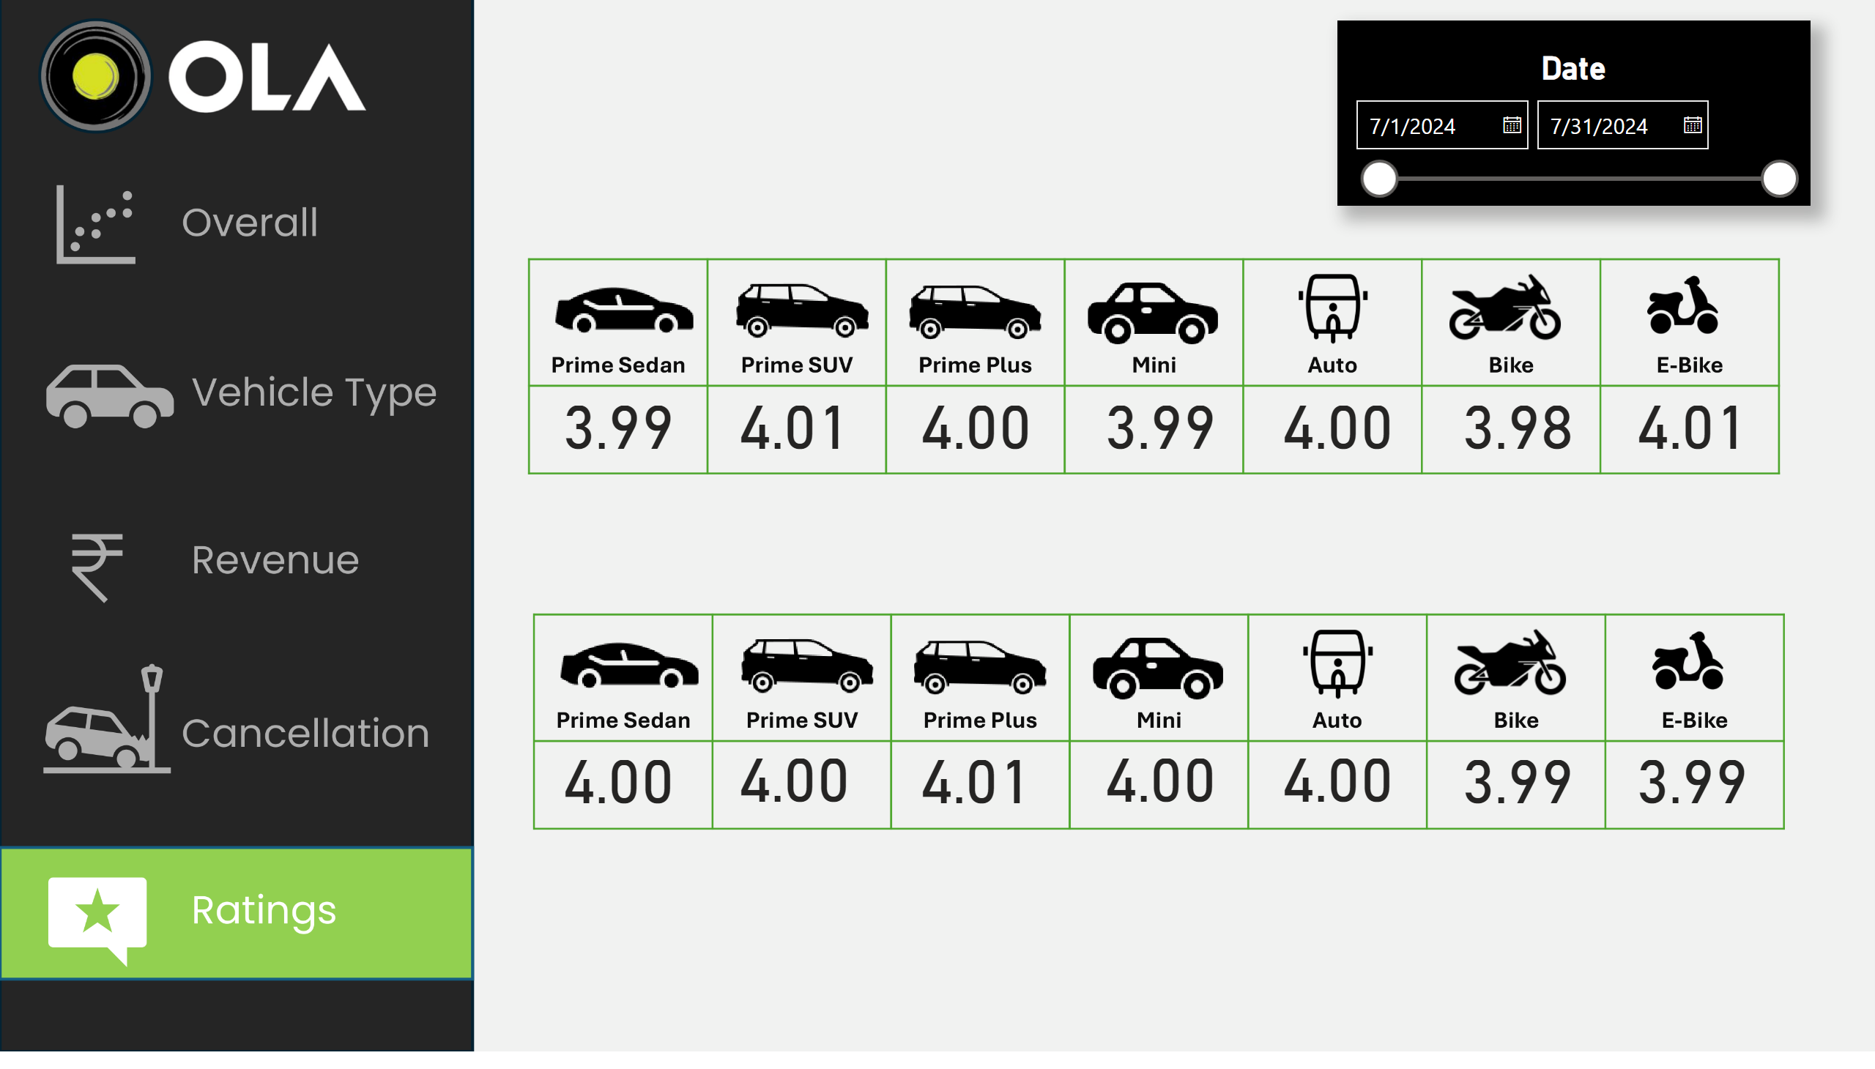
Ratings
Driver rating
Customer rating
Badda Vishweshwar
Notes:
actionButton
No alt text provided
actionButton
No alt text provided
actionButton
No alt text provided
actionButton
No alt text provided
actionButton
No alt text provided
textbox
No alt text provided
Date
No alt text provided
card
No alt text provided
card
No alt text provided
card
No alt text provided
card
No alt text provided
card
No alt text provided
card
No alt text provided
card
No alt text provided
textbox
No alt text provided
textbox
No alt text provided
card
No alt text provided
card
No alt text provided
card
No alt text provided
card
No alt text provided
card
No alt text provided
card
No alt text provided
card
No alt text provided

